Slide 1
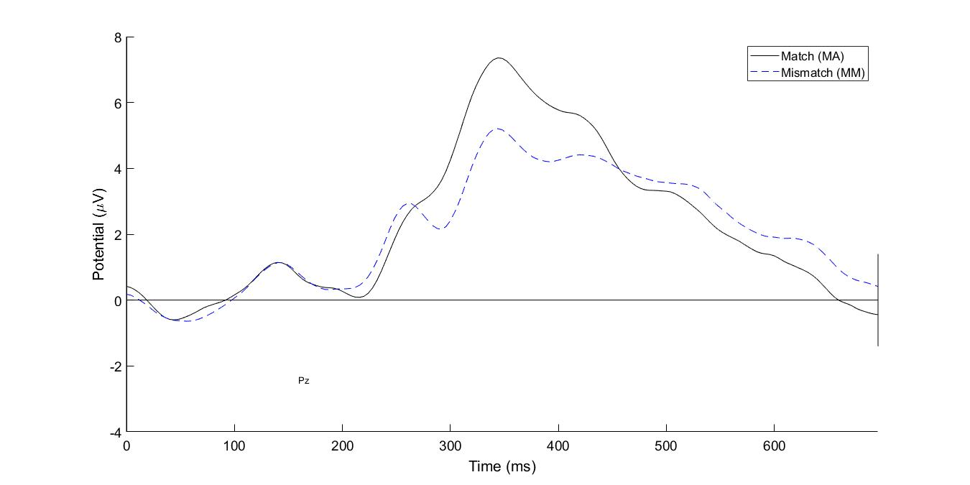
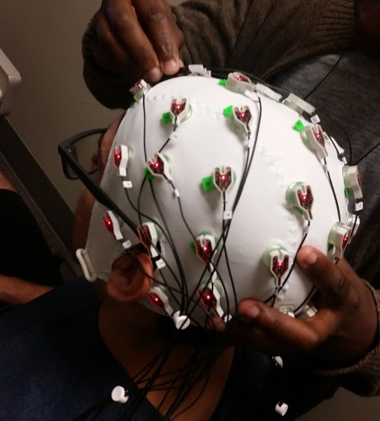
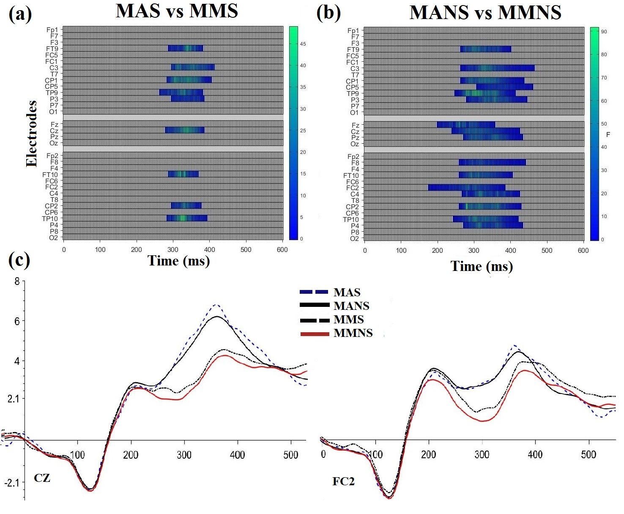
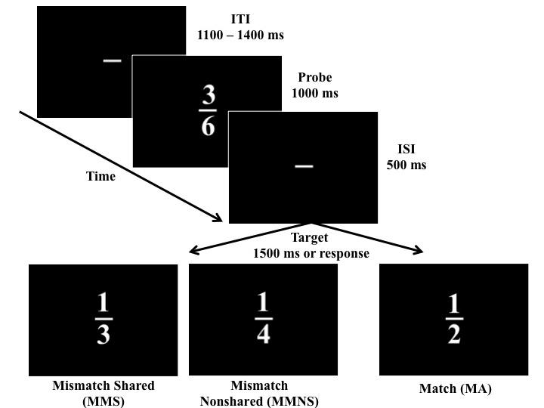
The Effect Of Shared Components In Fraction Comparisons
Brian Rivera
Faculty Advisor: Firat Soylu
Introduction
Methods (continued)
Significance
Fractions
Difficult for students to master but key for overall math achievement (Siegler, Fazio, Bailey, & Zhou, 2013)
One of these difficulties is managing the potential conflicting numerical information from components
The N400
An event related potential (ERP) difference wave observed during semantic incongruence
Paradigm used in language processing also adapted to numerical tasks
N400 will be used to examine the role that shared components play in a fraction magnitude comparison task
Electrophysiology
EEGs were recorded using a 32-channel system
ERPs will be calculated for Match and Mismatch conditions across Shared and Nonshared group
Mass Univaraite Analysis will be used to determine significance (Groppe, Urbach, & Kutas, 2011)
The N400 can be used for studying component effects in fractions
The susceptibility to interference from shared components could highlight the presence of a Stroop-like conflict between a fraction’s magnitude and its numerical components (Meert, Grégoire, & Noël, 2010)
This finding would point to the need of inhibition in fraction processing
Future Directions
Expand set of stimuli to other fractions (including double digit fractions)
Study how the N400 is affected by numerical distance effect (NDE) of both magnitude and components
Figure 2. Typical ERP waveforms for electrode Pz showing averaged amplitudes.
Figure 3. 32 electrode EEG cap used in ELDEN lab.
Methods
Expected Results
Educational Implications
Participants
30 participants
Task
Participants will judged whether a probe fraction (e.g. 3/6, 3/9 or 2/8) has the same magnitude (Match vs. Mismatch) as a target (1/2, 1/3 or 1/4)
A further division will be made based on the presence of shared components making groups MatchShared (MAS), MismatchShared (MMS), MatchNonshared (MANS), and MismatchNonshared (MMNS)
Participants will completed 600 randomized trials
Behavioral Results
A condition (Match/Mismatch) x component (Shared/Nonshared) interaction where the Shared component group in the Mismatch condition will show higher reaction times and lower accuracy when compared to the match condition
EEG Results
Permutation-based cluster differences for all 32 electrodes will be calculated on the 0-600ms time range
Shared components will modulate the amplitude of the N400 across match/mismatch comparisons showing componential interference
Inhibition might have a key role in the development of fractions
Inhibition of interference can draw on attentional resources resulting in higher overall reaction times and higher N400 amplitudes
Higher levels of inhibition have been shown to predict fraction comparison proficiency (Gómez, Jiménez, Bobadilla, Reyes, & Dartnell, 2015)
Inhibition might not simply be a feature arising during fraction judgment but a cognitive function necessary for successful fraction processing
References
Fazio, L. K., DeWolf, M., & Siegler, R. S. (2016). Strategy use and strategy choice in fraction
magnitude comparison. Journal of Experimental Psychology: Learning Memory and
Cognition, 42(1), 1–16. http://doi.org/10.1037/xlm0000153
Gómez, D. M., Jiménez, A., Bobadilla, R., Reyes, C., & Dartnell, P. (2015). The effect of
inhibitory control on general mathematics achievement and fraction comparison in middle school children. ZDM -Mathematics Education, 47(5), 801–811.
http://doi.org/10.1007/s11858-015-0685-4
Groppe, D. M., Urbach, T. P., & Kutas, M. (2011). Mass univariate analysis of event‐related brain potentials/fields I: A critical tutorial review. Psychophysiology, 48(12), 1711-1725
Meert, G., Grégoire, J., & Noël, M.-P. P. (2010a). Comparing the magnitude of two fractions with common components: Which representations are used by 10- and 12-year-olds? Journal of Experimental Child Psychology, 107(3), 244–259.
http://doi.org/http://dx.doi.org/10.1016/j.jecp.2010.04.008
Siegler, R. S., Fazio, L. K., Bailey, D. H., & Zhou, X. (2013). Fractions: The new
frontier for theories of numerical development. Trends in Cognitive Sciences,
17(1), 13–19. http://doi.org/10.1016/j.tics.2012.11.004
ELDEN Lab
Figure 1. Experimental progression of a Match (MA) or Mismatch (MM) trial showing a MismatchShared(MMS), MismatchNonshaed(MMNS), and MatchNonshared for 1/3, 1/4, and 1/2 respectively.
Figure 4: Hypothesized cluster differences between MatchShared (MAS) and MismatchShared (MMS) (a) and between MatchNonshared (MANS) and MismatchNonshared (MMNS) (b).
Embodied Learning Design & Educational Neuroscience

